Slide 1
Occupational Licensure Coverage and Climate Moving forward with license data
Amanda Rohrer
Notes:
JobHistory table released in October, opportunity to answer some of the questions that have been lingering. What kind of coverage is there? Does the time series align with other sources? How far would I trust this data?
Two approaches – top level and detailed industry comparison

Slide 2
Introduction
Brief overview of occupational licensure: what it is and why it matters.
The growing role of licensure in the U.S. workforce.
Key questions: How has licensure changed over time? What are the policy trends? How do reforms impact the workforce?

Slide 3
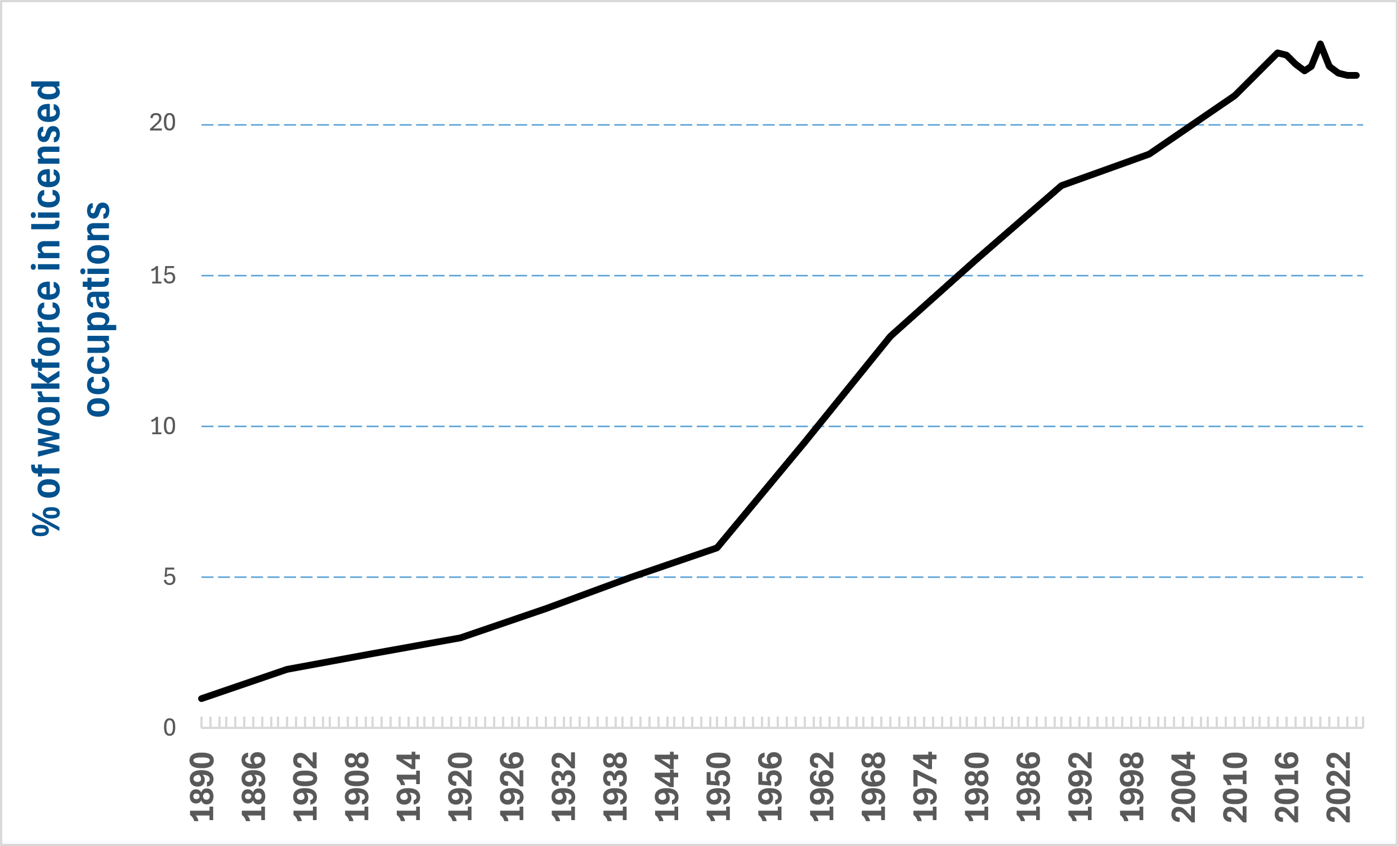
Occupational Licensure Coverage: Long-Term Trends
Historical growth in licensed occupations (CPS self-reported data, ~20% plateau).
Based on ARC data, ~26% of OEWS jobs may require a license
Sources
For 2015 forward, from BLS, based on annual averages of Current Population Survey (CPS), from Table, 50, "Employment status by certification and licensing status and selected characteristics," at www.bls.gov/cps/demographics.htm#certs_licenses

Slide 4
Occupational Licensure Coverage: Long-Term Trends
 |  | 2023 OEWS Employment
soc2 | Title | Sum of Licensed Employment | Total National Employment | % of Natl Emp reqs a License
290000 | Healthcare Practitioners and Technical | 7,917,190 | 9,284,210 | 85.3
170000 | Architecture and Engineering | 1,849,230 | 2,539,660 | 72.8
230000 | Legal | 758,530 | 1,240,630 | 61.1
250000 | Educational Instruction and Library | 4,130,190 | 8,744,560 | 47.2
210000 | Community and Social Service | 1,098,630 | 2,418,130 | 45.4
330000 | Protective Service | 1,433,470 | 3,504,330 | 40.9
470000 | Construction and Extraction | 2,510,210 | 6,225,630 | 40.3
410000 | Sales and Related Occupations | 4,819,670 | 13,380,660 | 36.0
130000 | Business and Financial Occupations | 3,241,920 | 10,087,830 | 32.1
110000 | Management Occupations | 3,286,300 | 10,495,770 | 31.3
390000 | Personal Care and Service Occupations | 816,890 | 3,040,630 | 26.9
190000 | Life, Physical, and Social Science | 372,050 | 1,389,430 | 26.8
310000 | Healthcare Support | 1,862,800 | 7,063,530 | 26.4
530000 | Transportation and Material Moving | 3,299,170 | 13,752,760 | 24.0
490000 | Installation, Maintenance, and Repair | 838,610 | 5,989,460 | 14.0
270000 | Arts, Design, Entertainment, Sports, and Media | 195,720 | 2,106,490 | 9.3
450000 | Farming, Fishing, and Forestry | 37,230 | 432,200 | 8.6
370000 | Building and Ground Cleaning and Maintenance | 361,180 | 4,429,070 | 8.2
510000 | Production | 430,280 | 8,770,170 | 4.9
430000 | Office and Administrative Support | 898,800 | 18,533,450 | 4.8
350000 | Food Preparation and Serving Related Occupations | 280,940 | 13,247,870 | 2.1
150000 | Computer and Mathematical | 64,180 | 5,177,400 | 1.2
licensure correlates with education levels
Breakdown by occupation (2-digit SOC data, highlighting high-licensure fields like healthcare, law, engineering).

Slide 5
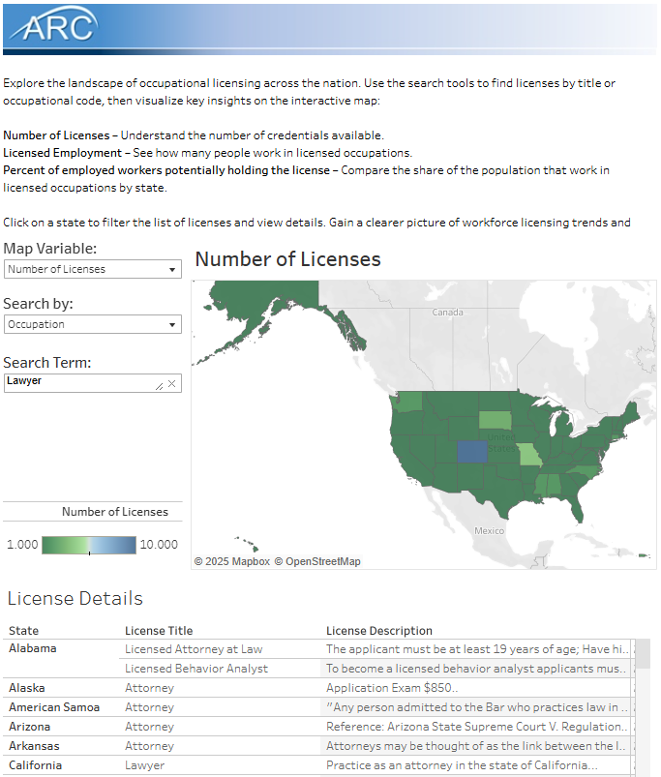
Coverage: More Detail
https://widcenter.org/occupational-license-coverage/

Slide 6
Common state-level licensure reform efforts
Reciprocity & interstate mobility: Expanding recognition of out-of-state licenses.
Criminal record restrictions: Reducing barriers for justice-involved individuals.
Fee standardization & reduction: Addressing financial burdens of licensure.
Military family exemptions: Easing transitions for service members and spouses.

Slide 7
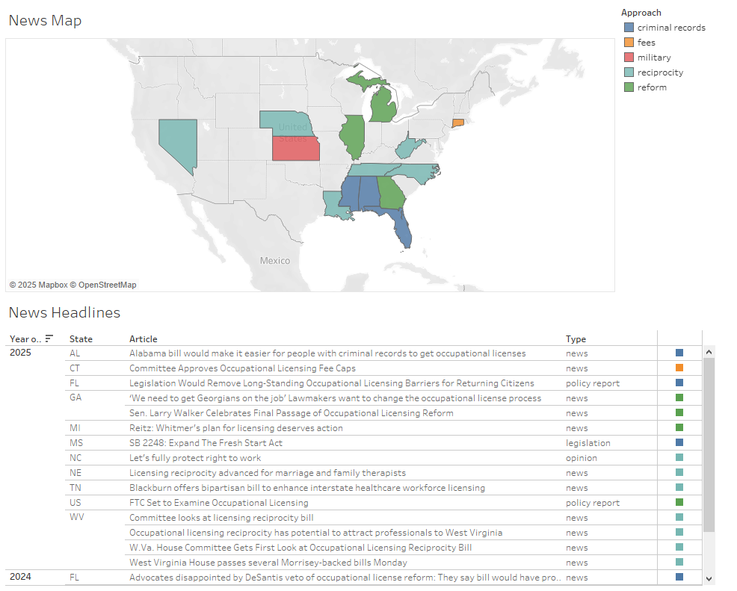
Recent Reform Efforts
Notes:
Examples:
Medication Aide – many states require that staff in nursing homes (supervised by medical staff like RNs) who distribute medication have to have a state-issued credential. All the ones I found were very short classes mostly summarizing the legal and ethical implications of getting medications wrong. I’m unclear if these are miscoded or just a similar job performed in the residential care setting.

Slide 8
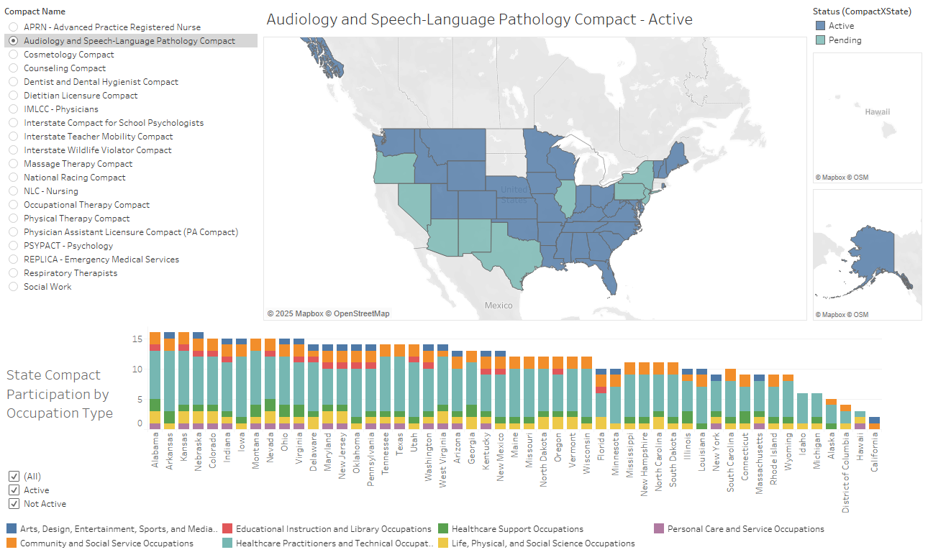
National License Compacts: A Growing Trend
Explanation of compacts: How they work and which industries use them.
Compacts vs Reciprocity
Map: State adoption of major national compacts.

