Slide 1
WIGS Occupational Licenses Deliverable History and Status
Amanda Rohrer
Notes:
JobHistory table released in October, opportunity to answer some of the questions that have been lingering. What kind of coverage is there? Does the time series align with other sources? How far would I trust this data?
Two approaches – top level and detailed industry comparison

Slide 2
Background and Timeline
1997 – Occupational License Collection by States begins
~2015 – CareerOneStop begins publication of licenses through the LicenseFinder
2017 – Compilation of state files moves to Minnesota
2019 – Content review is completed, data quality improvements implemented
~2020 – ETA encourages more reliable data submission from states
Present: Maintenance and Seeking Improvements
Findings:
All states had data BUT…
Some was quite out of date
Many were missing licenses like teachers
The contents of the Description field were so inconsistent as to be unusable
Occupational coding was inconsistent in taxonomy, number of matches, what license was assigned to what code, and in some cases it was just incorrect

Slide 3
Background and Timeline
1997 – Occupational License Collection by States begins
~2015 – CareerOneStop begins publication of licenses through the LicenseFinder
2017 – Compilation of state files moves to Minnesota
2019 – Content review is completed, data quality improvements implemented
~2020 – ETA encourages more reliable data submission from states
Present: Maintenance and Seeking Improvements
Findings:
All states had data BUT…
Some was quite out of date
Many were missing licenses like teachers
The contents of the Description field were so inconsistent as to be unusable
Occupational coding was inconsistent in taxonomy, number of matches, what license was assigned to what code, and in some cases it was just incorrect
Corrections:
Improved submission process
Compared to other data sources and manual review to identify missing licenses
Used machine learning techniques and other sources to derive values for new structured variables from existing descriptions
Centralized coding for consistency and to reduce state workload

Slide 4
Summary of 2019 Improvements
Centralized occupational coding
Reviewed contents of state files against other sources (CSOR, L2W, NCSL) and commonly licensed occupations
Added licenses where needed
Helped assign preliminary values to descriptive variables
Began archiving submitted data and notes/contact people
Added descriptive variables to make contents more comparable between licenses
Collected federal licenses, license compacts, began industry-specific logic
All of this improved the data quality enough to justify an overhaul of the LicenseFinder application, but much of the data supplied by states was still very outdated

Slide 5
2020s
With the improved LicenseFinder application and the rise of some partner organizations ETA started pushing for improved data submissions (CredentialsEngine)
TEGL now has a specific date annually for submission
Regional program staff actively advocate for it
Internal automation improvements to how data is validated and merged
More reliable
Faster, since we’re now processing 20+ state submissions in sequence
Better documented in case of turnover or cross training
Began internal application for review/analysis
Allows easier checks and display of licenses across states for coverage and data quality
Could enable editing in app for modifications between submissions by COS or other LMI staff

Slide 6
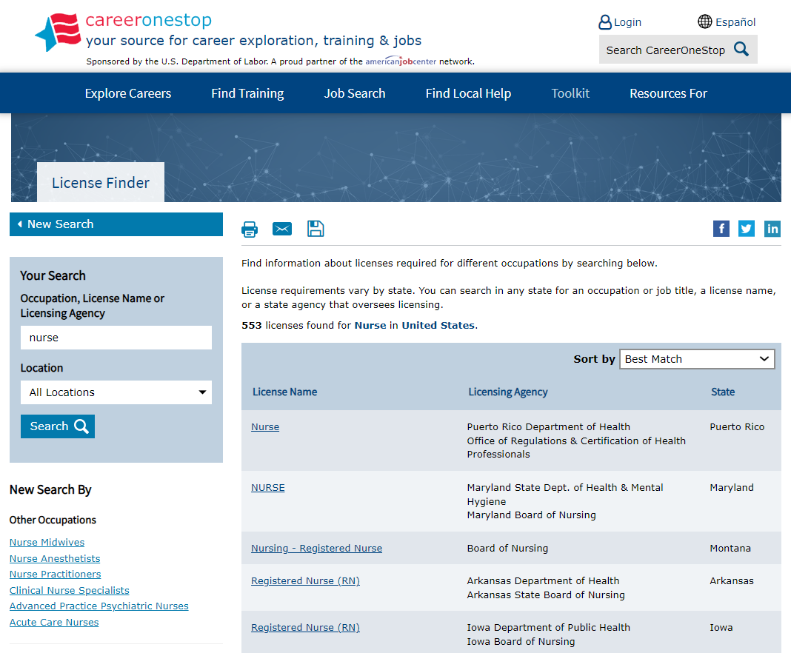
Publication
LINK
In terms of page views, the License Finder consistently gets about 40,000 monthly hits
For CareerOneStop, this is on the smaller side (the biggest tool Interest Assessment gets 1.6 million a month)
The data is also integrated into state, private, and ONET websites via API, so actual visibility of the data is much higher viewed alongside occupational profiles

Slide 7
Collection Methods
Every single state, department, and board has different ways of managing licensure
Most delegate responsibility for licensure requirements to a board of experts for each occupation
Boards can be numerous and not well-staffed or not staffed throughout the year
The amount of detail in state statute granting that authority varies widely
The Departments responsible for supporting boards and licensees are inconsistent from state to state
The information available to applicants varies widely – online portals, pdf documentation, license lookup
Some states have invested in centralizing information about or administration of licensure but most have not
Some have partially centralized licensure
States where the administrative side is more standardized – a central licensure department, consistent state statute language – can use less labor-intensive methods of data collection by LMI
More Technical >
More Administrative >

Slide 8
Discarded Ideas – North Carolina Application
ARC Member state North Carolina developed an application for managing occupational license updates. We investigated if the code could be made available to other states.
Positives:
Well-designed with a lot of data quality checks built in
Field-tested and liked by LMI staff
Manages relationships with disparate license boards well
North Carolina has shared applications before with success
Negatives:
North Carolina has state statute requiring boards to share this information with LMI office annually, many states do not
The software was developed within a particular IT environment and couldn’t be easily implemented in every state
A lot of what it manages is communication with boards – there are approvals and toggles from the LMI staff for edits from Board staff. That’s still a lot of management of users and interactions and couldn’t scale nationally
There are 2-3 LMI staff people involved in the project, time and redundancy a lot of states don’t have
Conclusion:
We don’t have the resources to maintain something like this on a national scale and most states don’t have the resources or mandate to do it themselves

Slide 9
Discarded Ideas – Scraping State Data
For states that have particularly out of date submissions or clear gaps in content, we’ve experimented with scraping license details off their websites
Positives:
Technology heavy rather than labor, doesn’t necessarily require state involvement
Can be kept current with published state information
Negatives:
Break frequently, require people with technology skills to maintain
Data quality is very low unless there’s significant manual review
Does not match with submitted data
Websites are sometimes badly structured or don’t contain necessary data
Can’t scale to the national level – there’s no way this could be done for every state without having substantially more people devoted to working on it full-time
Some state websites are actively designed to block this
Managing stakeholders would be a bigger part of the task
Conclusion:
The data quality is so much worse overall that in the long run this approach would probably make it unusable. Helping states scrape particular departments in a narrow, targeted way is the most you could reasonably get from this approach

Slide 10
Discarded Ideas – National Application
We discussed requirements for a national application for submitting, reviewing, and editing licenses, including talking to states about their requirements.
Positives:
Close relationship with Utah team could make it integrate well with existing resources
Could solve some of the submission requirements and could give review options
Could make documentation and training easier on states since at least part of the process would be the same for everyone
Negatives:
Doesn’t solve the problem of contacting boards and no one has the resources to manage them as separate users on a national scale
For states that have existing, well-managed processes, the upload option could actually be clunkier
Conclusion:
Any application we could build with the scale of funding/staffing available to us could make data editing, submission, and review easier, but not solve what people have consistently told us is the biggest pain point – getting the information from the boards.

Slide 11
Discarded Ideas – CredentialsEngine
At ETA’s request, we discussed publishing data to CredentialsEngine, a non-profit provider of credentials data, to make it more widely available to the public.
Positives:
Increases visibility through their partnerships and SEO
They have linkages to programs that could potentially be useful to job seekers
Negatives:
Does nothing to help with data collection since it assumes a high degree of ownership over the credential by the data submitter
Licenses cannot be deleted even for data quality reasons and they have already been created by organizations that don’t own them
Requires a much more dynamic update cycle than our current process, increasing state burden
Publishing interface is technically complex and requires IT staff to mediate
Conclusion:
After conversations with ETA, the data quality deterioration that would come from publishing to the platform and being unable to clear out bad records are too much of a downside to pursue this at this time

Slide 12
More Realistic Ideas
Documentation and Training
Documentation is mostly limited to technical structure, could add process recommendations
Training is limited to requested one-on-one virtual meetings. Is there a better way?
Reaching correct people
Improvements in the submission process
Online interface and responsiveness
Better defining file types

Slide 13
Suggestions/Support?
What is your specific state circumstance for licensure?
What are state training needs?
What are state documentation needs?
What are the specific pain points for this deliverable?
What would make things better?

